Slide 1
Sprint 1 Presentation
By Buddis
Formerly Known as Piratez

Slide 2
Updates to the BRD & Management Plan
Updated our main goal and premise of our app to be academics related
To reflect the main purposes of our app
Changed our target from web app to mobile app
Demographic & Primary Market Research Analyzed
User ease of use and efficiency prioritized

Slide 3
Product Requirements Document

Slide 4
Product Goals
Key goals
Mobile app that allows students to freely and openly share what they need to study for
Connect with students on campus and help each other with material and study habits
Alleviate awkward “first-step” of physical interaction where students ask each other to study outside of class
Develop strong study habits through automatic scheduling capabilities (machine learning)

Slide 5
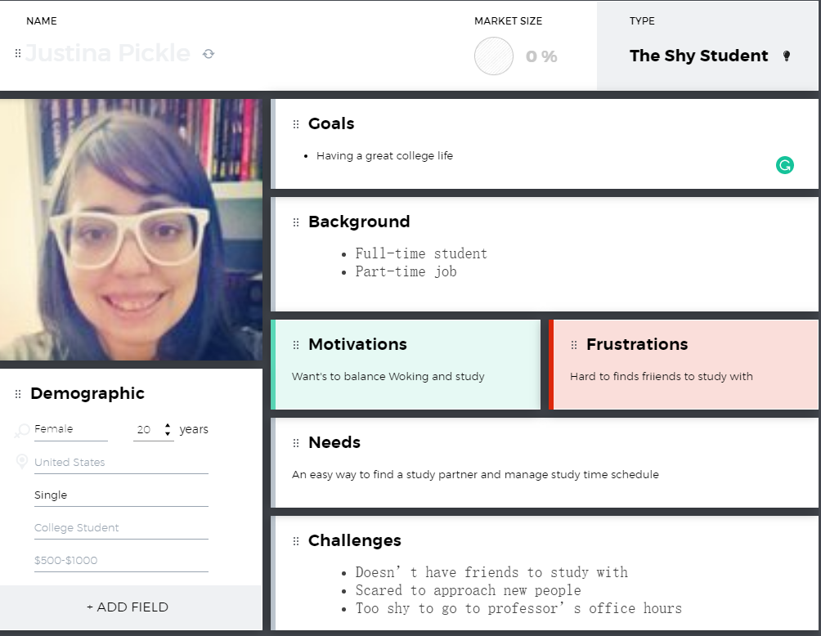
User Personas
The shy student
The new student
The international student

Slide 6
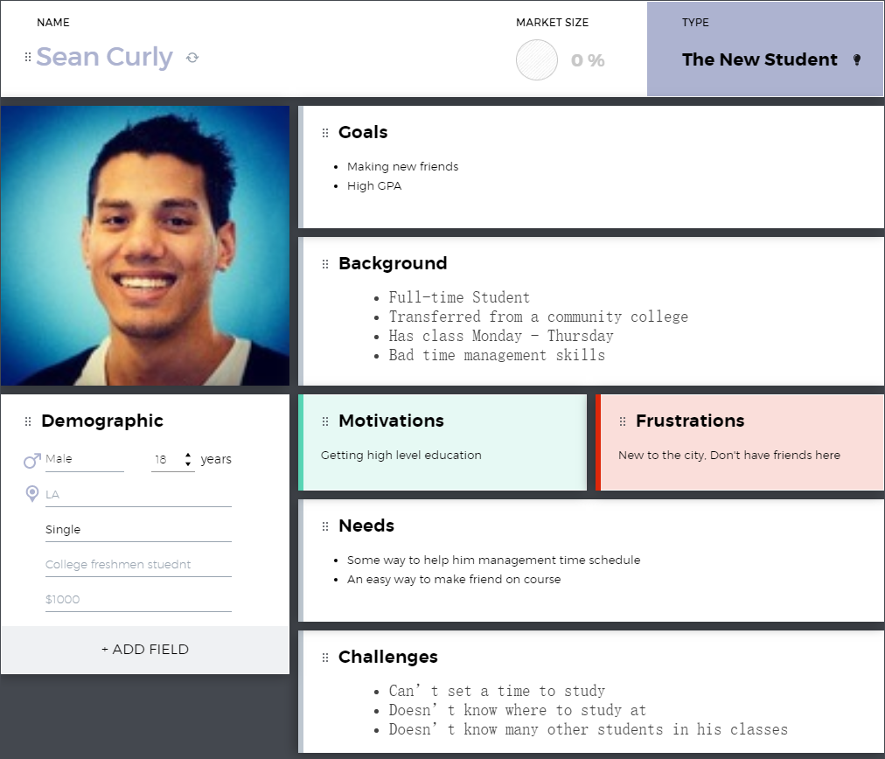
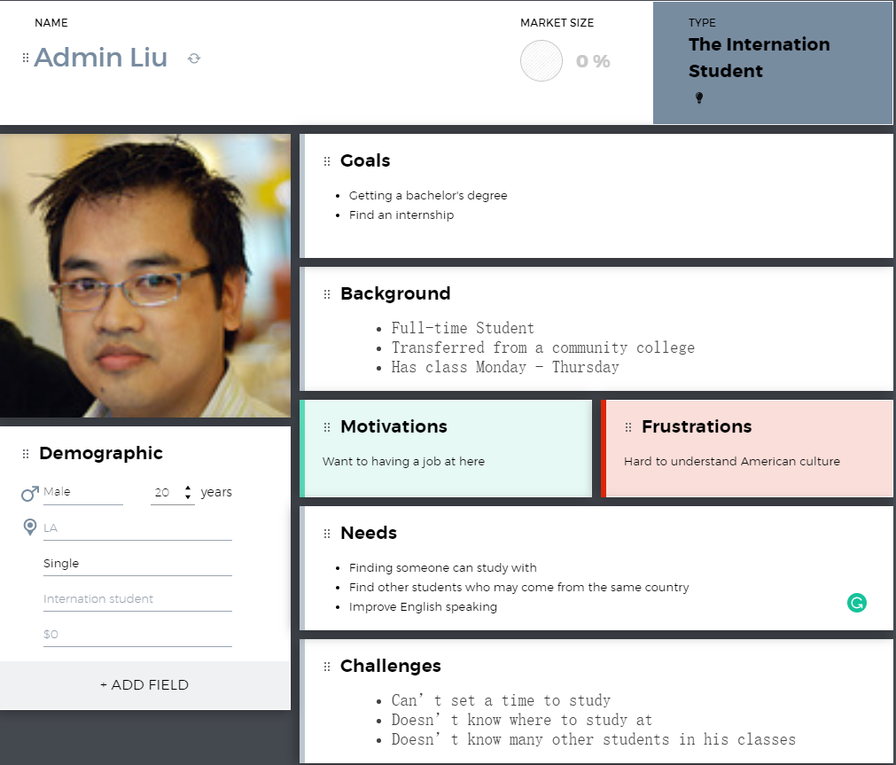
User Personas
Notes:
Mention or add the third persona

Slide 7
Key user stories
Most significant: Creating a studi session
A user can create a studi session with another user
A user cannot already be in another studi session with another user
Create post
A user can create a post with the title of the class, subject, and description of what they are struggling with in the class
Accepting a studi session
A user can accept a studi session from another user
Allows the user to join a studi session

Slide 8
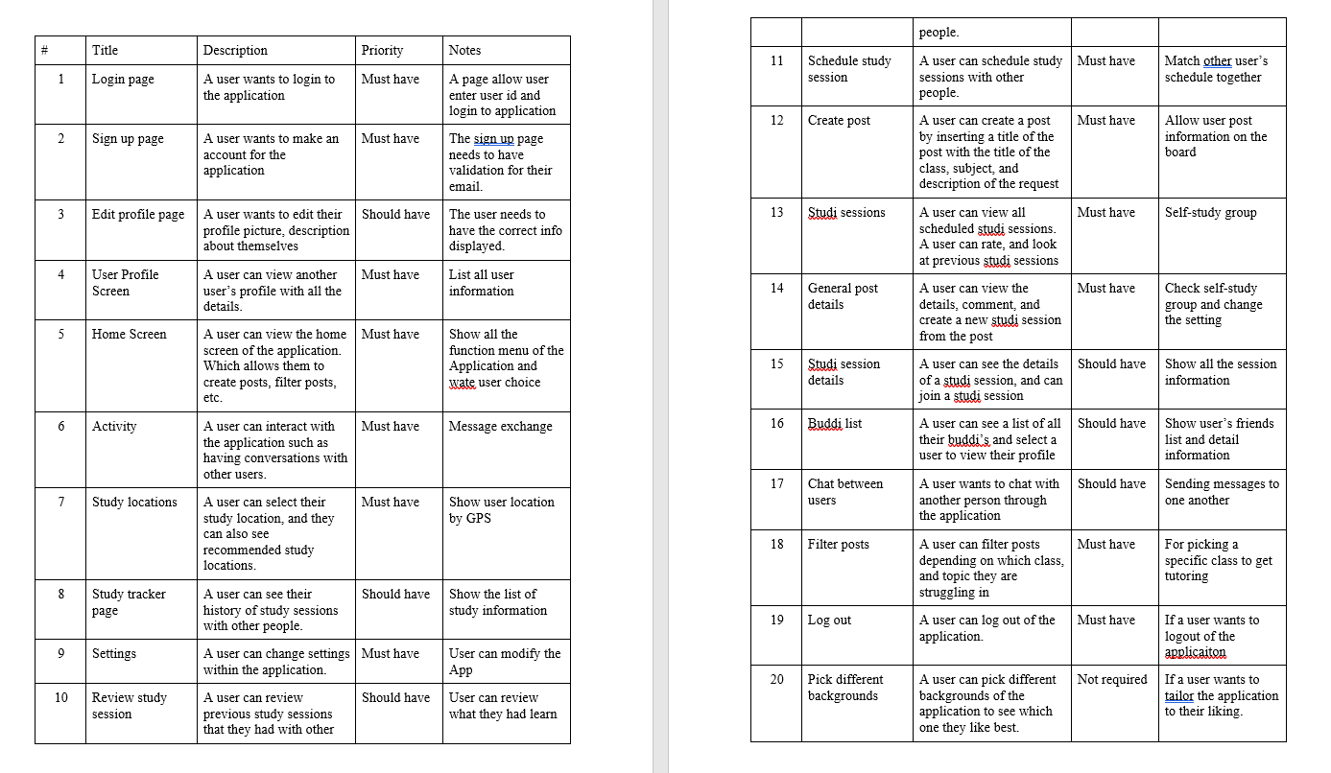
User stories as documented in PRD

Slide 9
In progress user stories
Currently all of the user stories are in progress
We have not had a code release yet
For each user story there should be at least 3-6 tasks

Slide 10
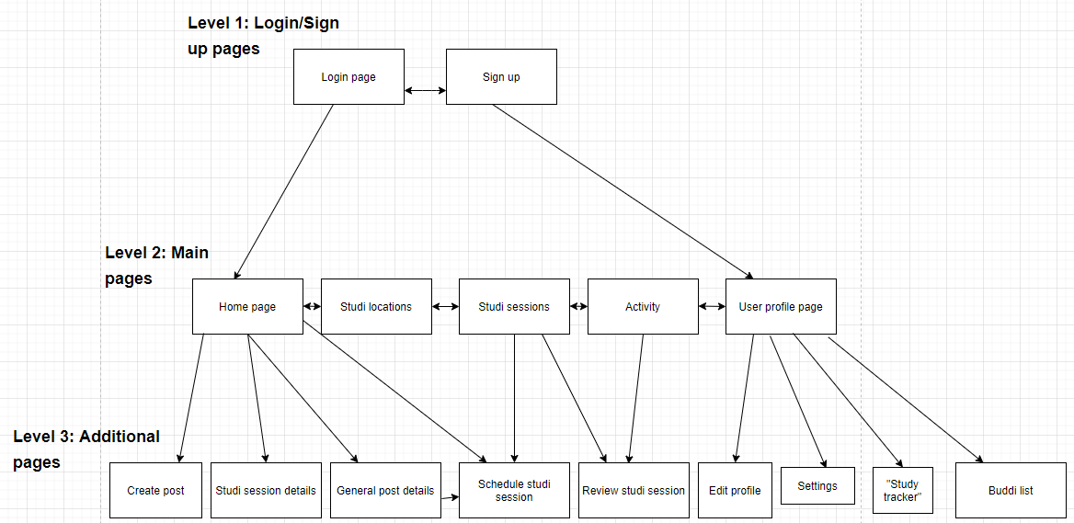
Server Sitemap

Slide 11
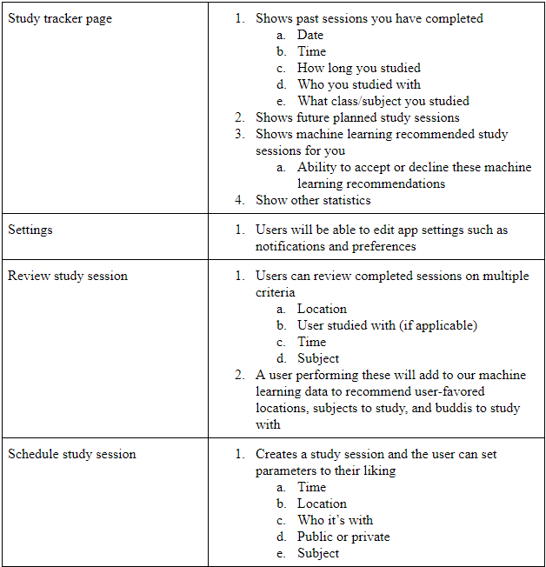
Page Descriptions

Slide 12
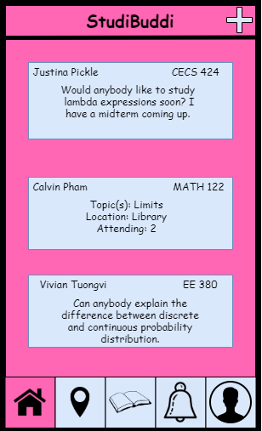
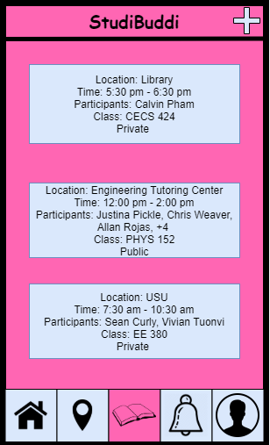
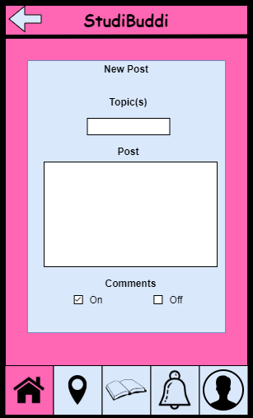
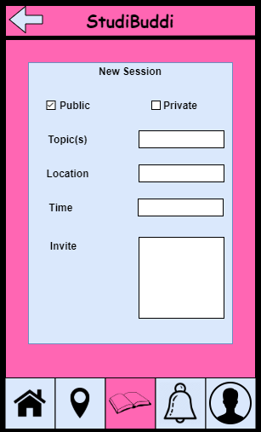
Wireframes

Slide 13
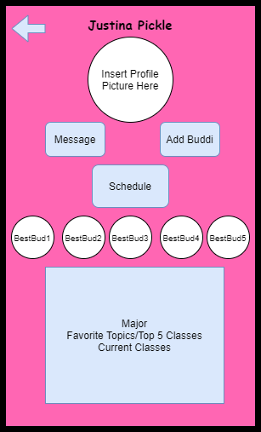
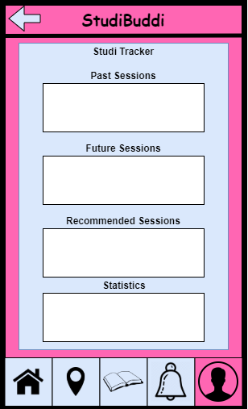
Wireframes

Slide 14
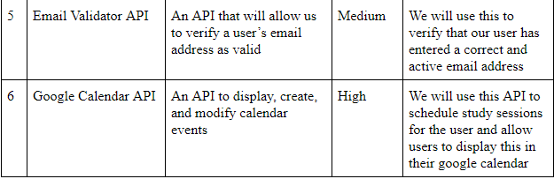
Interfaces

Slide 15
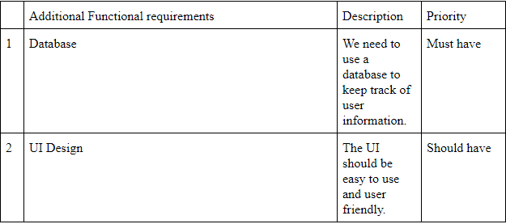
Additional Function Requirements

Slide 16
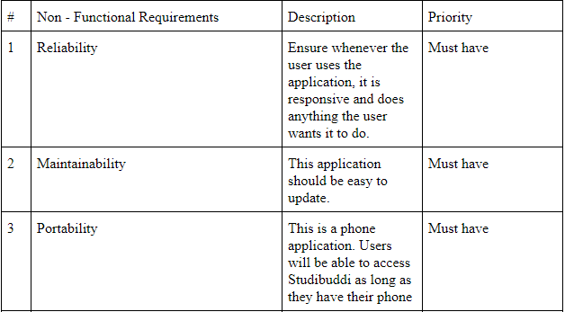
Non-functional Requirements

Slide 17
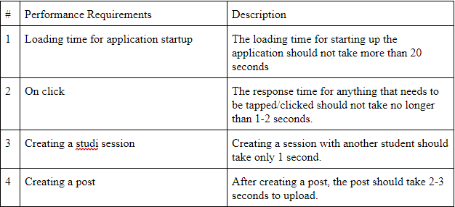
Performance Requirements

Slide 18
Future Iterations
Generality
Available on both Mobile operating systems
Safety
User safety
When user going to meeting someone should know
Data safety
Avoid data breach
Privacy
Even data breach happened, user privacy should be safe
Accessibility
Adding more useful feature in future

Slide 19
Architecture and Design Document

Slide 20
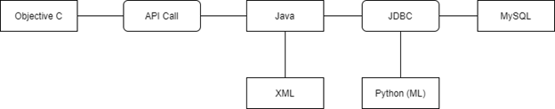
Diagram - languages

Slide 21
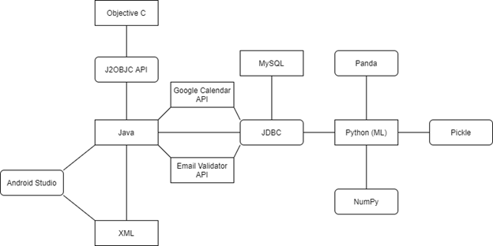
Diagram - Frameworks/APIs Integration
7 APIs
1 Server (MySQL server)

Slide 22
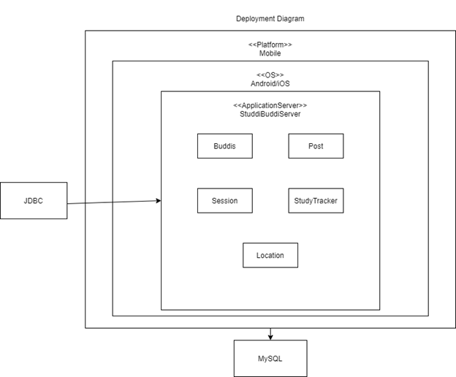
Diagram - Deployment Diagram (database)
MySQL
Will use MySQL to store all information needed
Chosen since everyone has experience and we prefer to use JDBC with database tables we create ourselves

Slide 23
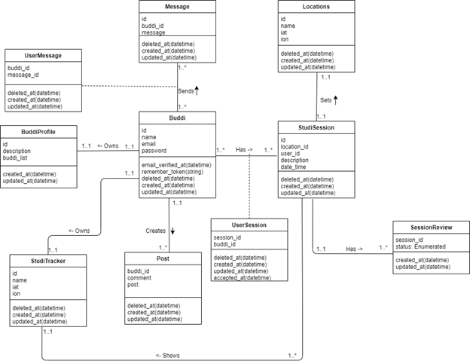
Diagram - Class Diagram (components/classes)
Classes reflect key objects and their behaviors in our app

Slide 24
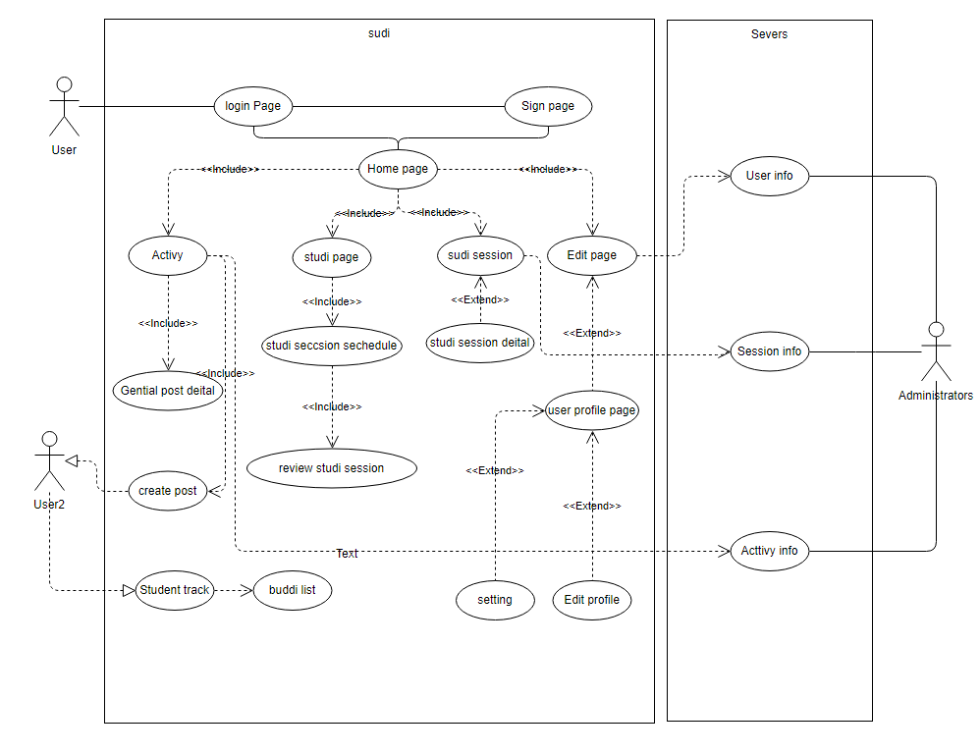
Diagram - Use case Diagram

Slide 25
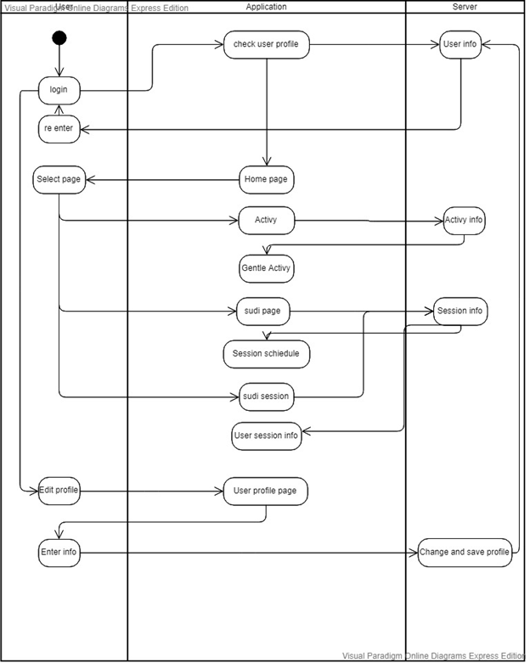
Diagram - Activity Diagram

Slide 26
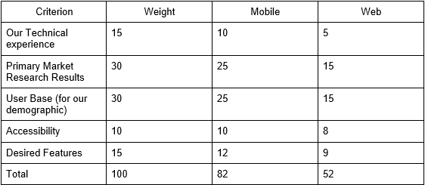
Mobile vs. Web Tradeoff Analysis

Slide 27
Android vs iOS Tradeoff Analysis
Criterion | Weight | Android | Apple
Our Technological Experience | 20 | 15 | 5
Accessibility | 10 | 8 | 7
Audience | 10 | 7 | 8
Timeline | 5 | 3 | 4
Software Features | 20 | 15 | 10
Hardware Features | 25 | 23 | 20
Performance | 10 | 8 | 8
Total | 100 | 79 | 65

Slide 28
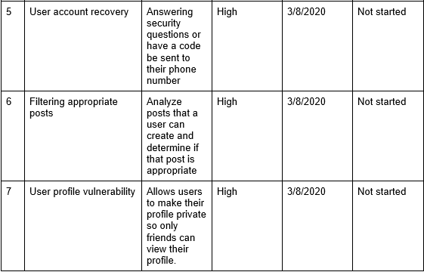
Risk Management

Slide 29
Main Coding Language
Java
JDBC to be used with MySQL
Mobile application development for Android
Any potential additional server requirements

Slide 30
Architecture Alternative
Firebase
For easier database implementation
Web application
Would change the architecture of our app in various ways
PHP or Node.js for MySQL
Different languages and frameworks

Slide 31
User platforms
We originally planned this application to be a website but due to our primary market research, we decided to move this to a mobile app
This would be more convenient for students since phones are much more convenient for them to use.
We also do not have to learn a new language to program the application

Slide 32
Management Plan

Slide 33
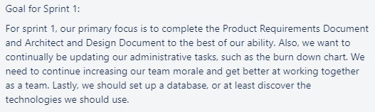
Sprint Goal

Slide 34
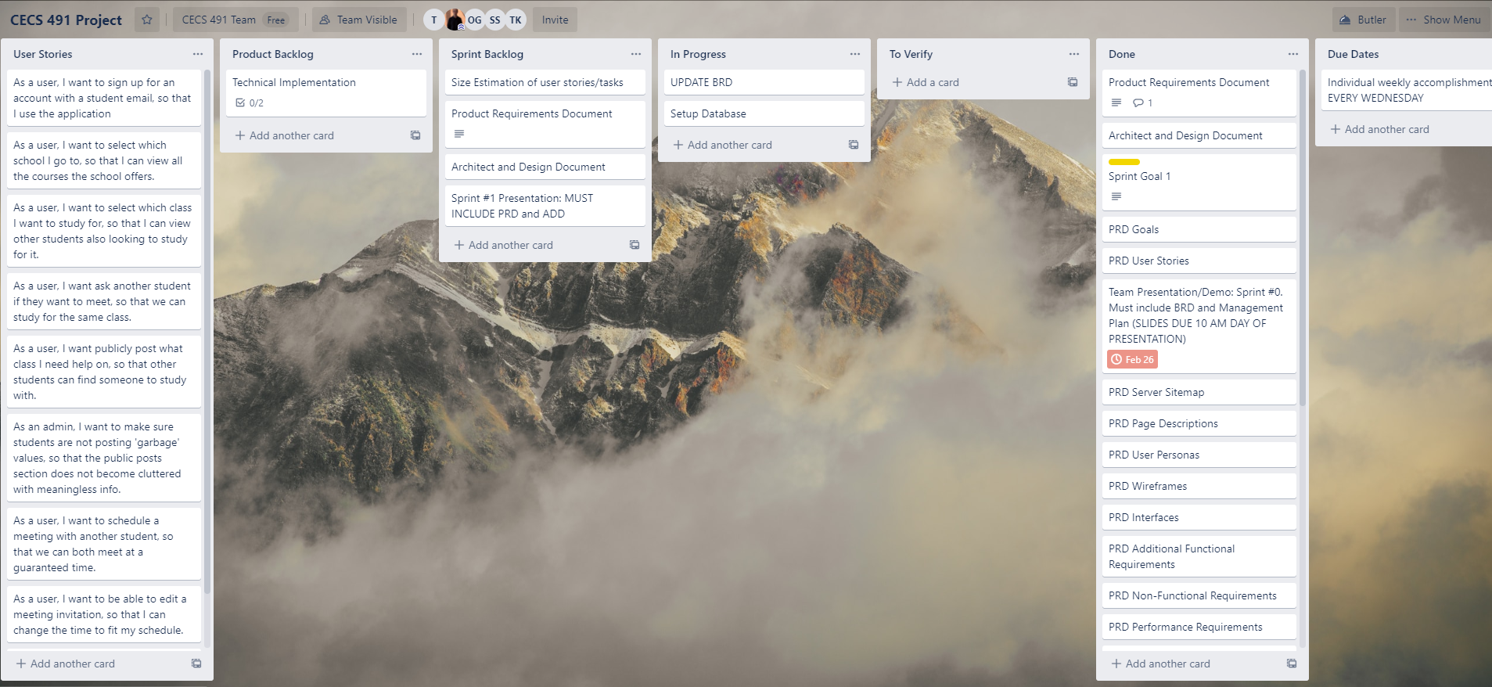
Sprint Board - End of Sprint #1

Slide 35
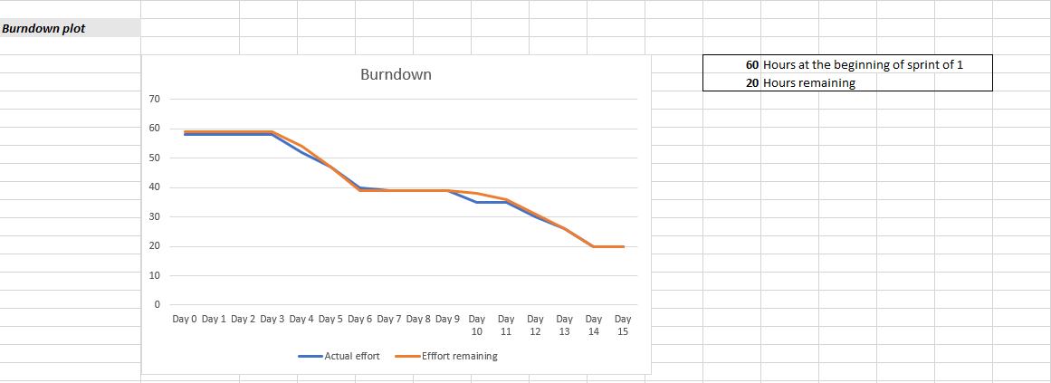
Burndown Chart

Slide 36
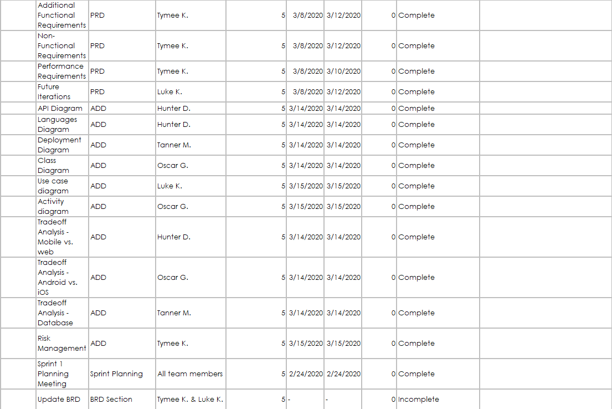
Project Tracking Matrix

Slide 37
Sprint Review
40 story points completed (60 story points planned)
Tasks planned and completed
Product requirements document
Architecture and design document
Tasks planned and not completed
Business requirements documents
Did not set up database, but began login page
Highest priority stories selection
This sprint, it was decided by what tasks would affect our grade the most

Slide 38
Sprint Retrospective
Great - continue doing
Performed well as a team on PRD, led to a score we were happy with
High team morale
Consistently meeting outside of class
Poor - stop doing
Still not working at a consistent pace, waiting until specific days to do lots of work
Need better task delegation
Start doing
More coding
Notes:
hello

Slide 39
Plan for Next Sprint
Front end (Hunter & Tanner)
Android development
Back end (Tanner & Oscar)
Database design, API integration
Graphic Design (Hunter & Oscar)
Graphic design of app
Documentation and Planning (Tymee & Luke)
Updating our BRD, ADD, etc. as we go on
Language & Framework Learning (Everyone)

Slide 40
Velocity for Sprint 2
60 hours
Code release (30 hours)
Software demo of mobile app
Database design release (15 hours)
Completely new Business Requirements Document (10 hours)
Updated to reflect our new app
Select an accurate Machine Learning Model for our needs (5 hours)

